Slide 1
Analyzing Data From a Fictional Superstore
Summary Presentation with Recap & Recommendations
Darpan Mangwani | darpanmang@gmail.com

Slide 2
Summary
The following report consists of an analysis of a fictional Superstore in the US that is looking to gain actionable insights into the store’s performance across different years, regions, customer segments, product categories, product returns, and more.
In summary, between 2014 and 2017, the Superstore accumulated total sales of $2.30M and $286.40K in profits, resulting in a ~12.5% profit margin, whilst providing an average discount of 16%. Additionally, whilst sales did go down from 2014 to 2015, profits increased year after year – resulting in an 86% increase to profits when comparing 2014 to 2017.

Slide 3
5 Key Findings and Insights
West region outperforms East, South, and Central regions
The Technology category outshines the rest
The Consumer Segment drives the majority of sales
Sales and Returns peak in Q4
Profitability suffered due to high discount rates

Slide 4





Categories Explored
Sales and Profit Analysis
Regional Performance Analysis
Time Series Analysis
Product Performance
Returned Items

Slide 5
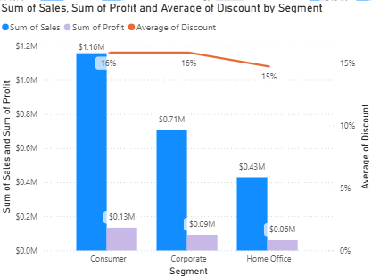
Sales and Profit Analysis
Hypotheses
Recommendations
H1: The consumer segment will contribute more to sales volume compared to the other segments
Result: Accepted
Capitalize on the brand’s digital presence
Meet the consumers where they spend most of their time
Expand in product offerings for consumers
Understanding the importance of the consumer segment → strengthen the relationship with customers
Build a loyalty program
Gamify the experience → Increase the consumers’ lifetime value

Slide 6
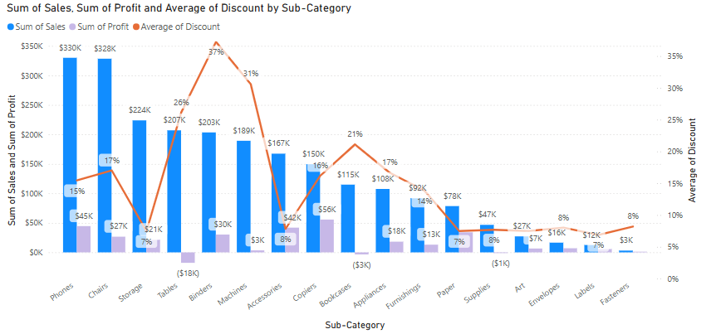
Sales and Profit Analysis
Hypotheses
Recommendations
H2: Some product categories and sub-categories generated high sales but low profits
Result: Accepted
Promote and introduce product bundling
Market Basket Analysis showed:
30%: papers and storage → binders
27%: fasteners → paper
Focus on sales volume to increase profits
Innovate with product trials
Customers can “try out” the product for a week
If wanting to return, apply a re-stocking fee
Consumers value their convenience

Slide 7
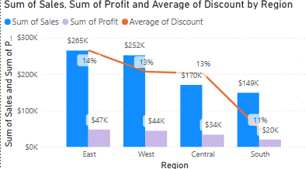
Regional Performance Analysis
Hypotheses
Recommendations
H3: Both Eastern and Western regions showed stronger sales in the technology category, compared to other regions
Result: Accepted
Prioritize products and cut costs to boost overall margins
Cut down on products that have prolonged discount rates in the region → thus improving overall profit margins
Anticipate regional demand
Focusing on the corporate segment: Central states like Texas are seeing high growth in company HQs
→ Partner with incoming companies

Slide 8
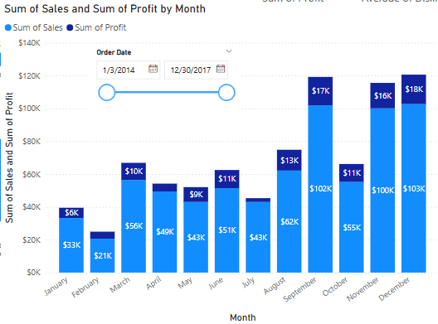
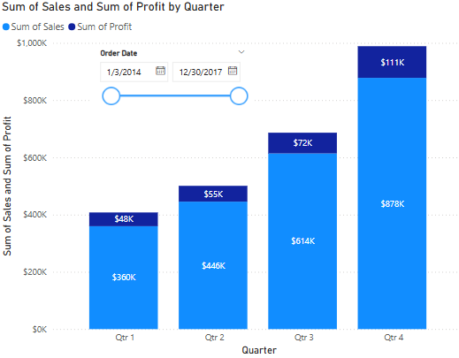
Time Series Analysis
Hypotheses
Recommendations
H4: Sales peaked during Q4 across all regions
Result: Accepted
H5: Office supplies category did best in Q3 (back to school months)
Result: Rejected
Learn more about the demographics around the customers
Identifying and knowing demographic data can better inform marketing tactics
Test the consumers’ price sensitivity for items in Q4
Last minute shopping → less sensitive to price increases
Office Supplies Category
Overall Sales

Slide 9
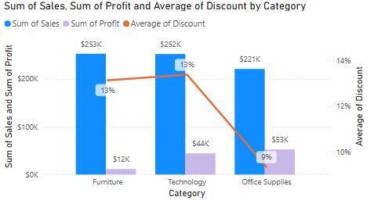
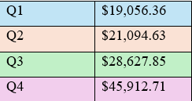
Time Series Analysis
Observation
Recommendations
In the West Coast, Technology is not the most profitable category. It usually represents higher margins → how to increase?
Perform forecasts to:
Reduce stockouts and overstocks
Optimize cost savings
Bulk order accordingly and reduce stock costs
Plan for centralized and de-centralized inventory management
2018 West Technology Forecasts

Slide 10
Product Performance
Hypotheses
Recommendations
H6: A small percentage of sub-categories drove the majority of profit (using Pareto Principle)
Result: Rejected (61%)
H7: In 2017, approximately 20% of sub-categories contributed to approximately 80% of profits
Result: Rejected (70%)
From the remaining sub-categories that did not enter the top 4 – identify opportunities for focus
Paper was 4th most profitable with many other sub-categories out-performing paper in sales
Distribute marketing spend across all sub-categories
Introduce and explore new categories
Less risk in adding new offerings since there is no over-reliance (Pareto Principle wasn’t satisfied)

Slide 11
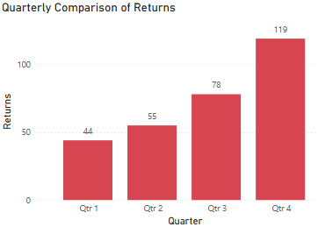
Returned Items
Hypotheses
Recommendations
H8: The consumer segment returned the most items
Result: Accepted
H9: Q4 saw the most returns during the 2014 – 2017 period
Result: Accepted
Operationally – plan for an increase in returns
Increase warehouse staffing & customer service representatives
Invest in educational/informational marketing for products
Office supplies saw the most returns → communicate more info around dimensions, uses, & durability
Speak to suppliers / cut ties with their products
Understand from suppliers reasons / trends for returns
Stop selling the products altogether to prevent the damage to sales

Slide 12
Overview of Immediate Strategies per Department
Department | Tactic 1 | Tactic 2
Sales and Marketing | Target customer segment | Refine regional promotional strategies
Product Management | Build product bundling | Enhance product descriptions
Customer Service | Improve return policies | Review feedback on returns
Operations and Supply Chain | Adjust inventory management in the West | Avoid excess stock during slower months
Finance and Accounting | Analyze profit margins and discount impact | Analyze financial impact of returns
Biz Dev and Strategy | Explore product expansion to test customer demand | Test new business models in low performing markets (partner with local designers)
Data Analytics | Gather information on demographics | Based off people’s demographics, analyze regional demand/ forecasts

Slide 13
Thank You

